Slide 1
CS/EE 147 – GPU Computing and Programming
Introduction
Daniel Wong, Assistant Professor
Department of Electrical and Computer Engineering
Cooperating Faculty, Department of Computer Science and Engineering
dwong@ece.ucr.edu

Slide 2
Welcome!

Slide 3
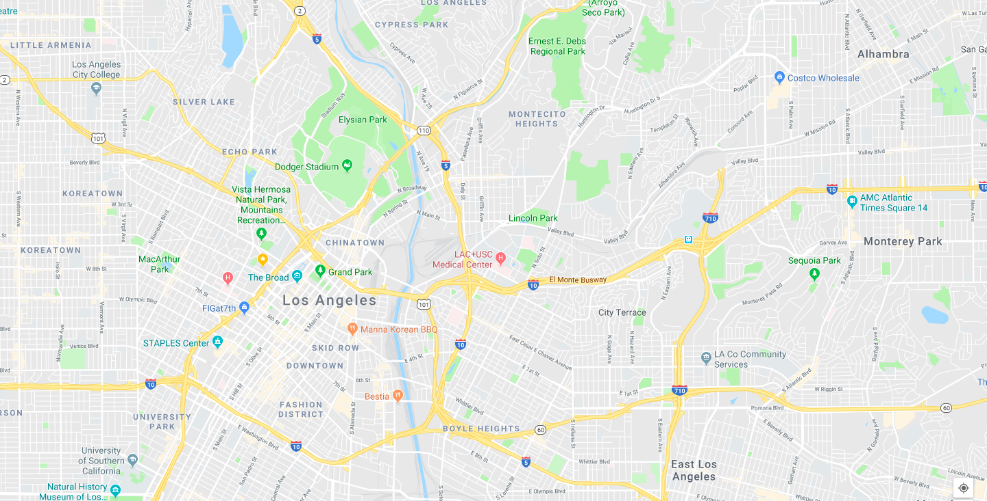

About Me

Slide 4

About me
University of Southern California, Los Angeles, CA
BS Computer Engineering/Computer Science ’09
MS Electrical Engineering ’11
PhD Electrical Engineering ’15

Slide 5

Why Computer Architecture?
AUVSI 2009 (RoboSub)

Slide 6
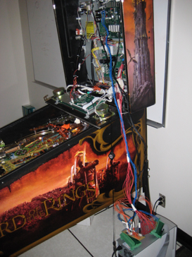
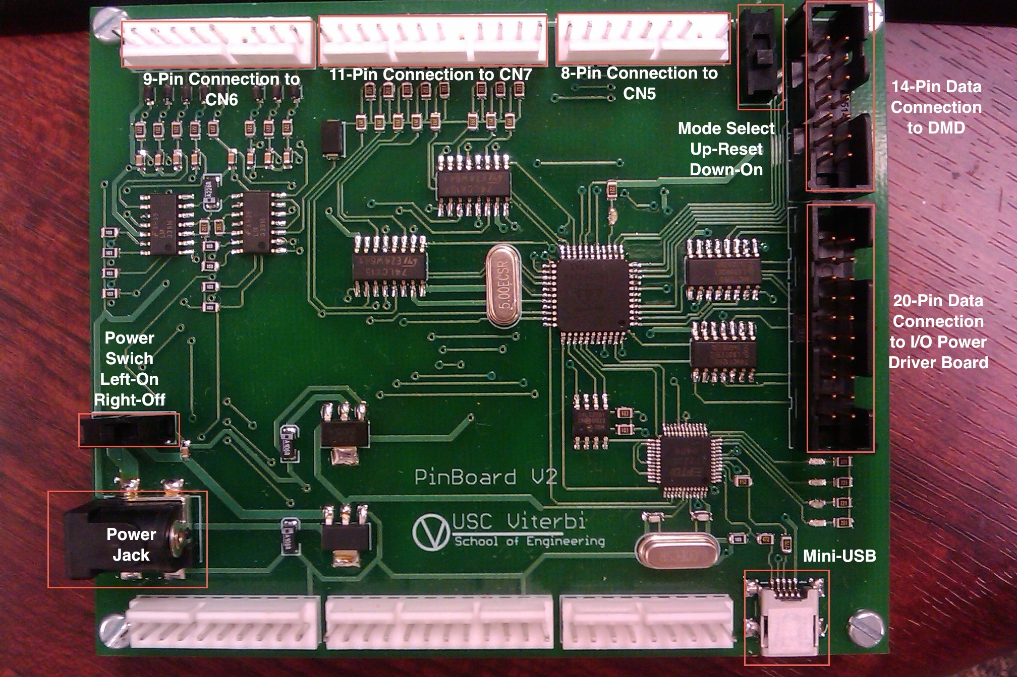
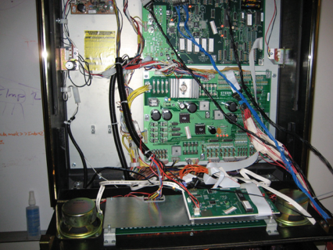
Why Computer Architecture?
Pinball Machines!

Slide 7

Why Computer Architecture?

Slide 8
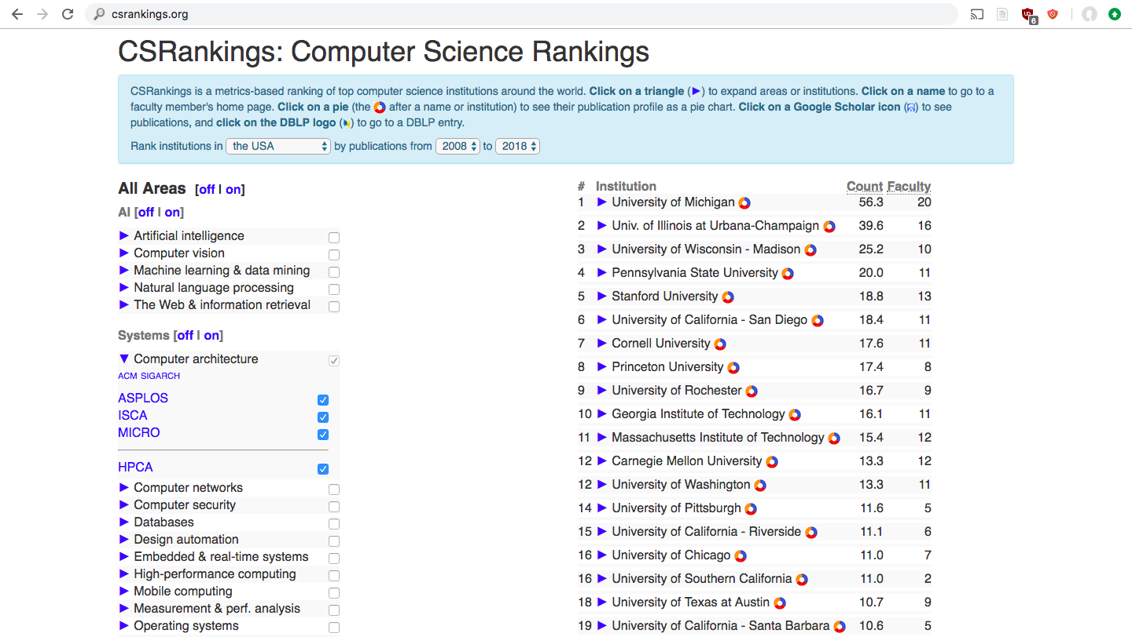
Why Computer Architecture?

Slide 9
Why GPUs?

Slide 10
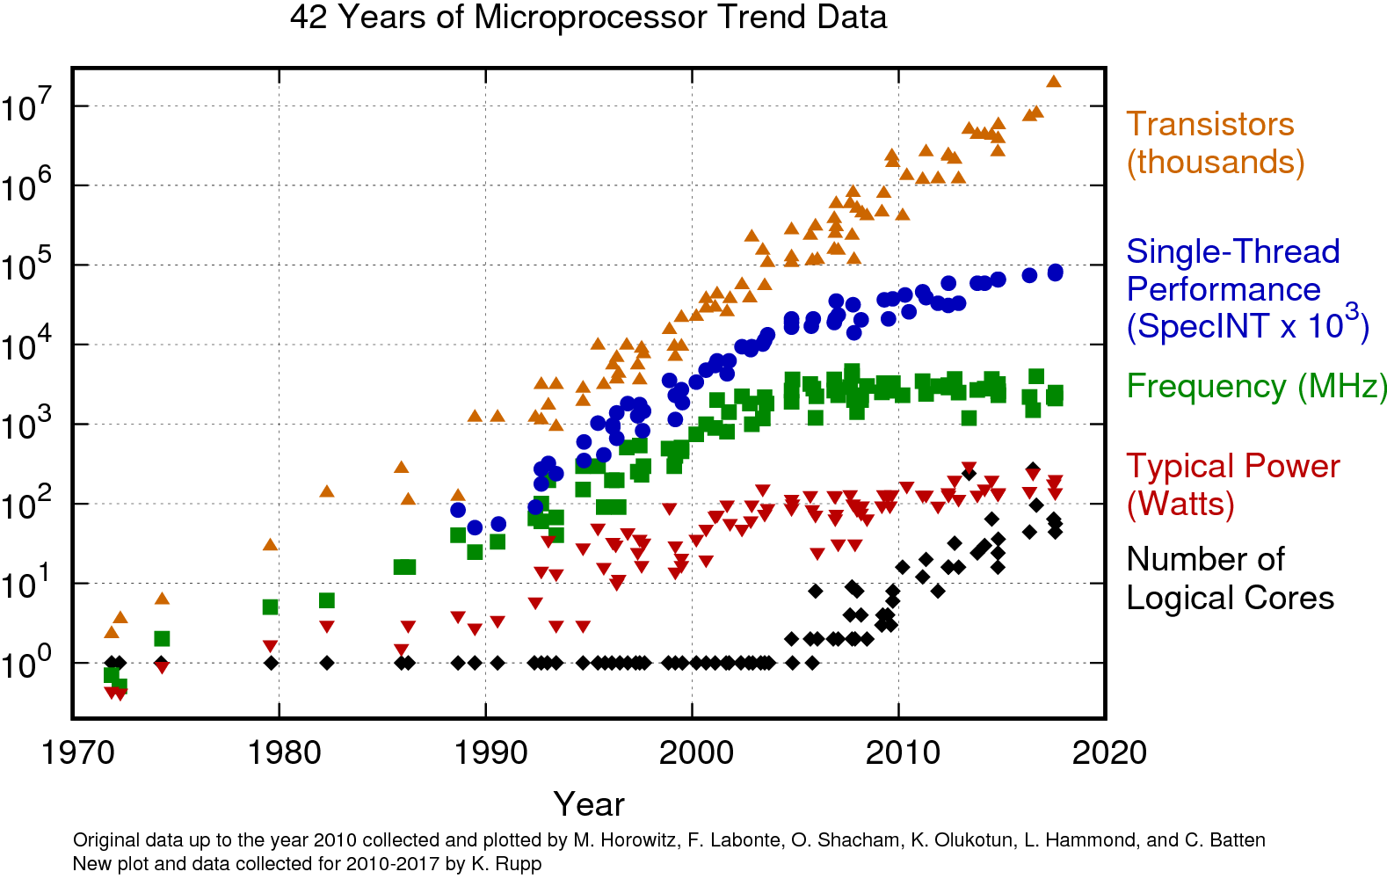

Slide 11
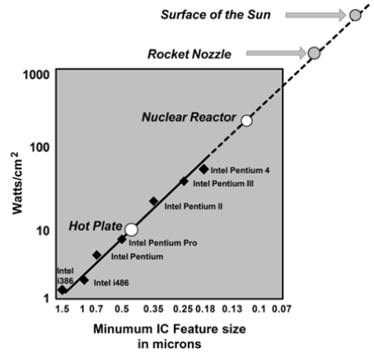

Slide 12
Modern computer architecture is limited by:
Process Technology / Transistor density (End of Moore’s Law)
Power (End of Dennard Scaling)
Temperature

Slide 13
General-purpose (Easier to program)
Single-core CPU
Multi-core CPU
GPU
FPGA
ASIC
Specialized
Energy-efficient

Slide 14

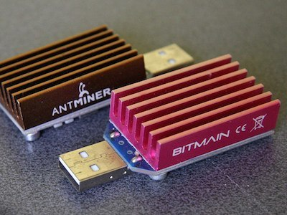
Examples of Specialization
Bitcoin Mining

Slide 15
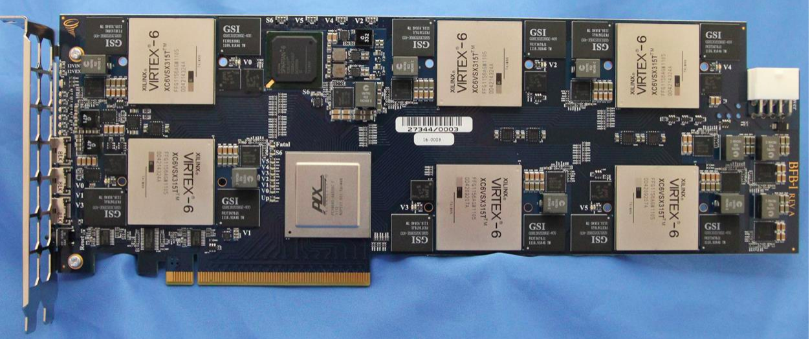
Examples of Specialization
Microsoft Catapult

Slide 16
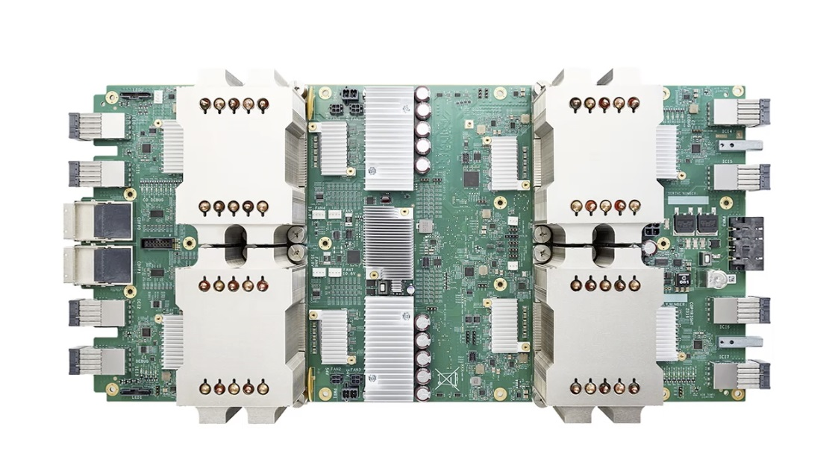
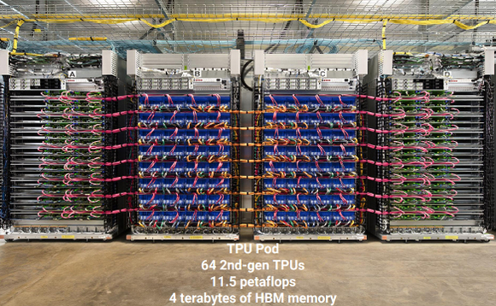
Examples of Specialization
Google TPU - Tensor Processing Unit

Slide 17
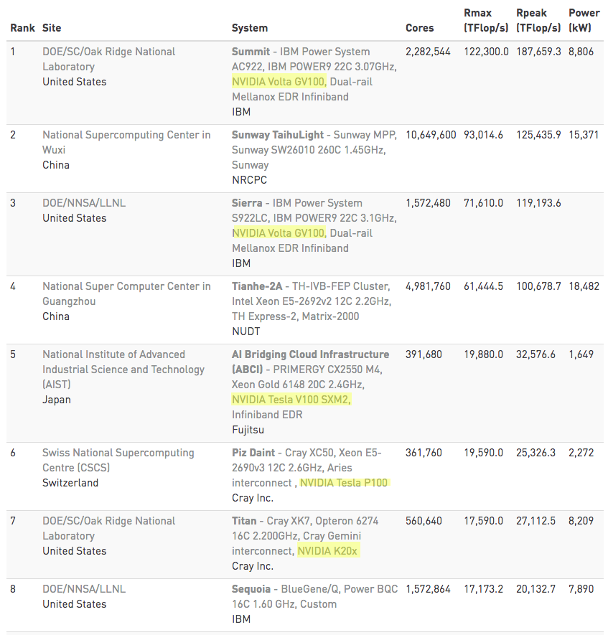
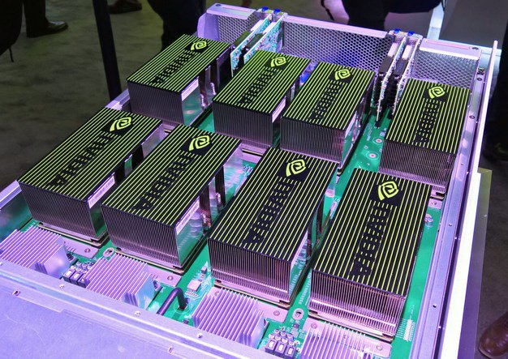
Examples of Specialization
GPUs - Supercomputers

Slide 18
Course Goals
Learn how to program GPGPU processors and achieve
high performance
functionality and maintainability
scalability across future generations
Technical subjects
principles and patterns of parallel algorithms
processor architecture features and constraints
programming API, tools and techniques

Slide 19
Logistics
Course Website
http://danielwong.org/teaching/csee147/spring19 Check often for announcements
Assignments/Projects
iLearn (iLearn.ucr.edu)
Discussion/Help
Piazza https://piazza.com/ucr/spring2019/ee147/home
ENGR Account Setup https://www.engr.ucr.edu/secured/systems/login.php

Slide 20
Textbook
D. Kirk and W. Hwu, “Programming Massively Parallel Processors – A Hands-on Approach, Second Edition”
CUDA by example, Sanders and Kandrot
Nvidia CUDA C Programming Guide
https://docs.nvidia.com/cuda/cuda-c-programming-guide/

Slide 21
Attendance/Grading
Attendance
You are expected to attend all lectures.
Some slides only make sense in lecture. ☺
Grade Breakdown
Homework/Labs: 20%
Exam and Final: 45%
Project: 30%
Class Participation: 5%

Slide 22
Lab Policies
3 slip days
15% penalty per late day
If it’s one minute late, it’s still late
No extensions will be given
All labs/projects are due at the end of the due date (midnight)
Projects should be uploaded to iLearn

Slide 23
Contact
Instructor: Daniel Wong
Email: dwong@ece.ucr.edu
Homepage: http://www.danielwong.org
Office: WCH 425
Office Hours: by appointment
TA: Kiran Ranganath
Email: krang006@ucr.edu
Office Hours: TBD

